Slide 1
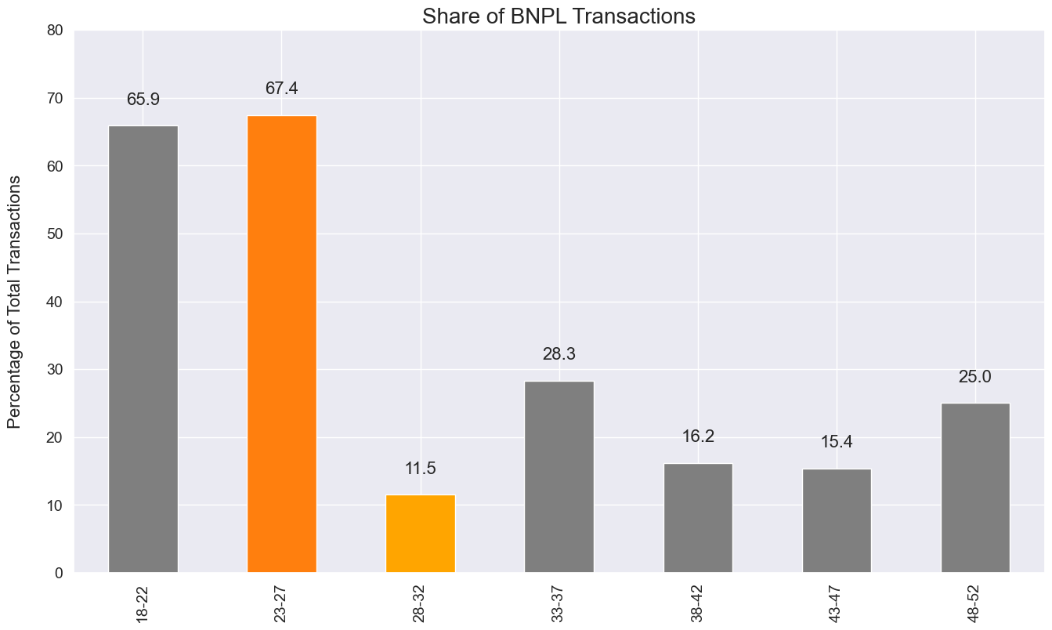
Younger age groups (18-27) show a strong preference for 'Buy Now, Pay Later' (BNPL) method
BNPL is the most popular payment method among younger age groups, accounting for 65.9% of transactions for the 18-22 age group and 67.4% for the 23-27 age group.
Meanwhile, the usage of BNPL drops significantly as the age group increases, with only 11.5% usage in the 28-32 age group, further reducing to 25% in the 48-52 age group.

Slide 2
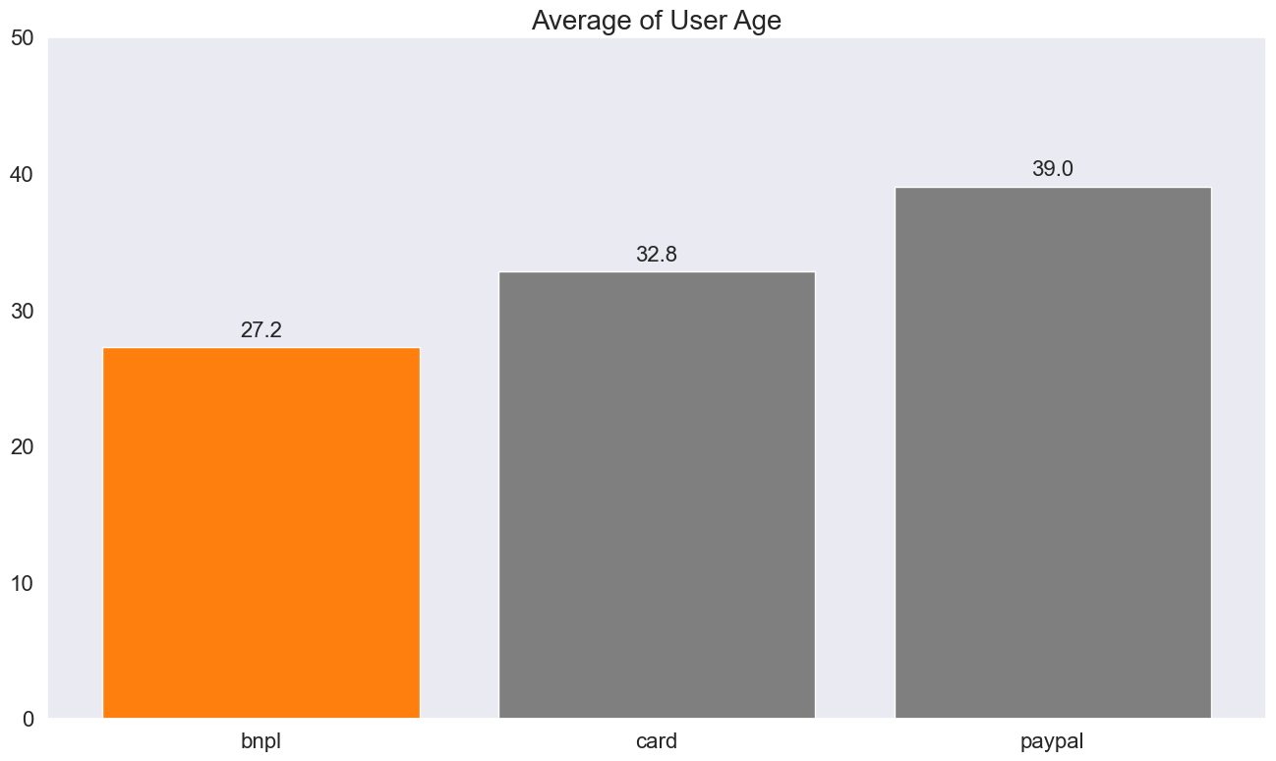
BNPL users have an average age of 27.2 years, followed by Card at 32.8 years and Paypal at 39.0 years
This further supports the conclusion that younger users prefer BNPL, while older users tend to use Card and Paypal methods.
On the other hand, older users continue to prefer traditional payment methods like Card and Paypal.
This suggests a shift in payment method preference as customers age, which could be a critical insight for companies in tailoring their payment options and marketing strategies.

Slide 3
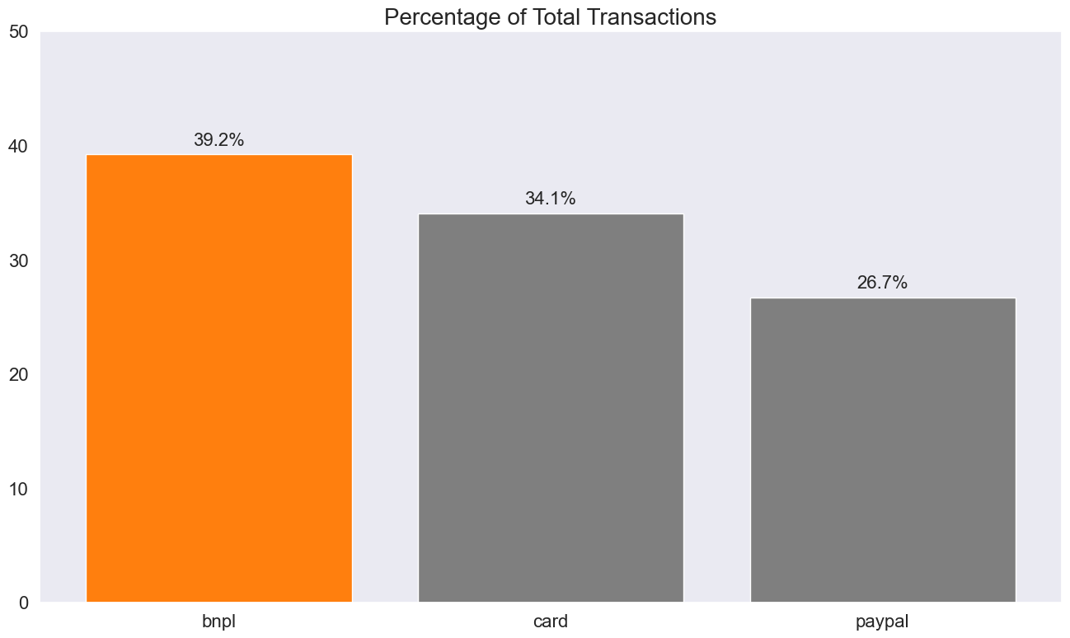
In terms of total transaction volume, BNPL accounts for 39.2% of total transactions, followed by Card at 34.1% and Paypal at 26.7%
This indicates that while BNPL is popular among younger users, traditional payment methods like Card and Paypal still hold a significant share of total transactions.
This could be due to various factors such as financial stability, credit availability, technological savviness, and trust in different payment platforms.

